Slide 1

Introduction
Ian Phillips
  Engineering Manager
  Microprocessor Business Unit
  GEC Plessey Semiconductors
  Plymouth, UK
  phillips@roborough.gpsemi.com

Slide 2
GEC Plessey Semiconductors - GPS
GEC plc
$14Bn
GEC PLESSEY SEMICONDUCTORS
$360M
3000 employees
“Europe’s leading ASIC company”
State-of-the-art technology - both Bipolar and CMOS
A competitive and responsive supplier operating Globally
Wafer fabs in Europe

Slide 3
GPS - A Global Company
ASSP DESIGN CENTRES
  USA, Japan, Germany, UK
SEMI-CUSTOM DESIGN CENTRES
  Worldwide cover in 9 centres
CUSTOMER SERVICE CENTRES
  UK, France, Germany, Italy, Sweden, USA, Japan, Singapore, Taiwan
“80% of Sales outside UK .....and rising”

Slide 4
TECHNOLOGY - CMOS
40% of Sales and fastest growing
Digital and Mixed Signal
In-house
0.7 micron in production
0.5 micron being characterised
0.5 micron moves to pre-production Q4 1995
0.35 micron architecture being defined in Q2 1995
NEW Second Source
Foundry strategy on 0.6 micron now available 0.5 micron first half 1996
Same design rules
Fully interchangeable with in-house

Slide 5
TECHNOLOGY - BIPOLAR
33% of Sales
Mixed signal and High Speed
High speed 14GHz now and 25GHz Q3 95
Integrated coils and capacitors
Low noise
Low power
Process designed specifically for highly integrated radio

Slide 6
OMI/DE-ARM Program
To Create and Demonstrate a European Capability in the Design and Manufacture of 32 bit RISC based Deeply Embedded Microcontrollers - Apr 92
9 Partners and 4 Countries.
  GPS, ARM Ltd, UMIST, University of Manchester - UK
  IRIS, Elettronica - Italy
  VLSI - France
  Hagenuk, Hanover University - GDR
Through the establishment of ...
  System Design Methodology
  System Test and Debug Methodology
  Support Modular Macrofunctions
  Technology Demonstrators/Product Prototypes

Slide 7
OMI/DE - GPS Work Packages
To overcome the specific difficulty of ‘fully incorporating’ external macrocells ...
  Polygon editing,
  Modeling, Simulation & Verification
  Fault grading
  Qualification, Manufacturing test and Characterisation
To develop the capability to produce Customised µCs ...
  Methodology to support modular design
  Use of ‘Hard-Macrocells’ - The ARM7 Core.
  Use of Modular VHDL to support Macrofunction design/reuse.
  Use of C functional models for performance & security of design data
  Co-design with Verilog & C models

Slide 8
µC, a Change of Emphasis
A CPU core is typically only 10-20% of total µcontroller die area
Therefore, what is important is the Silicon system architecture for:
  Power control and speed efficiencies
  Flexibility to match customers end system requirements.
and for Development:
  Visibility: Access of system’s internal operation
  Reliability: right first time, re-usable sub-functions
  Rugged software development Tools

Slide 9
Volume profiles
MARKET WINDOW
Highly optimised ASSP’s/CSSP’s
Fully Customised
Hi Volume
BµILD
100K units
Standard µControllers
Development
& Lower Vol
Projects
------------------ Time to Market ------------->

Slide 10
Modular µC Design Methodology
BµILD Bus Based ...
  Standardised Interconnect
  Supports Macro-function re-use
  Supports Modular Test and Characterisation
  Supports Modular Application Debug
Use of VHDL, synthesis and auto layout on structured array...
  Process portability
  Design re-use
  Compact, cost effective silicon
  Rapid product introduction
Incorporates C and Verilog circuit descriptions ...
  Inclusion of ‘externally designed’ macro-functions

Slide 11
MODULARITY - Re-usable functions
All new microcontrollers inherit ...
The BµILD environment - a modular silicon back-plane
Fast Time-to-market : Ensures GPS can introduce microcontrollers
that meet the latest demands of newly emerging high volume segments
Growing library of proven and reliable functions
The use of a common processor core and software drivers across
microcontroller products
For high volume projects; provides an interface standard via the BµILD
bus to integrate customer designed functions with GPS' library.

Slide 12
MANTIS Comm’s µController
Int<2>
DMA <4>
Chip selects
<4>
208PQFP
Bus
control
<9>
Enable
Watch-dog
Intr Ctlr
MPC
Address
<22>
<2>
Timers
DMA
Data
<32>
<5>
UART
Bus
Arbiter
<5>
UART
16 bits &
control
<24>
BμILD Bus
PPI
Clk & power control
Host I/F
<56>
PCMCIA
Clock
ARM7
Core
Debug &
Test<6>
BBM
POR
Reset

Slide 13
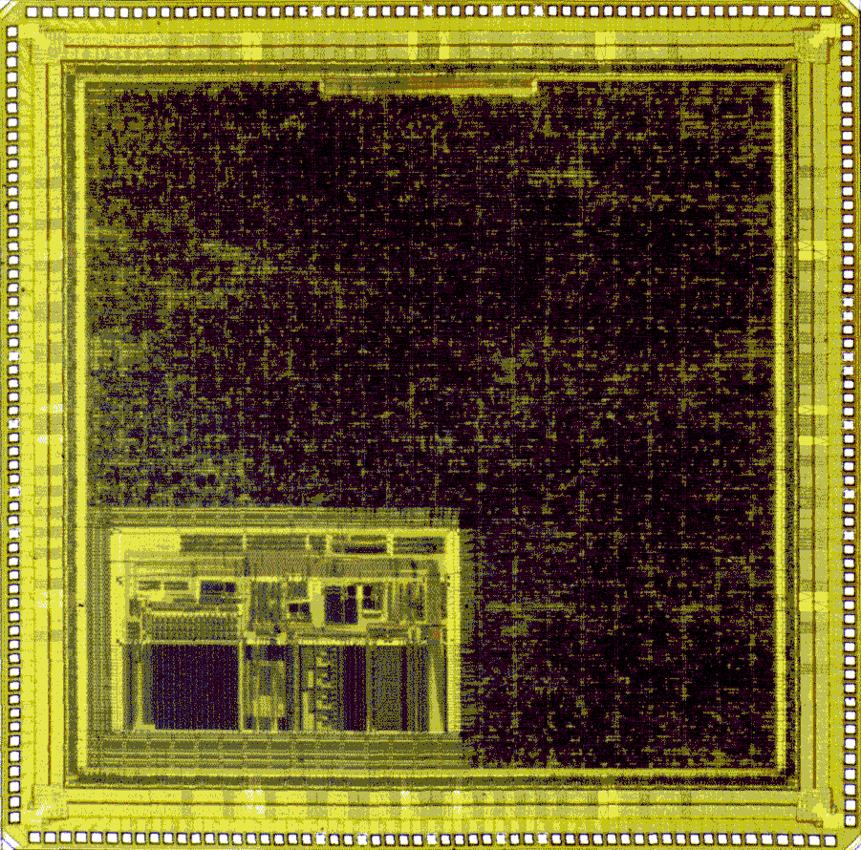
MANTIS µController - Logical
ARM7 32 Bit RISC Core - 33 MHz
4 Channel DMA
  Fully programmable memory/memory/IO
23 Channel Interrupt Controller
  2 ext. 21 int. Programmable
PCMCIA Slave Interface (Std v2.1)
  8/16 bit data, 1-26 bit address
Power Control
  Individual clock control and sleep mode
Memory/Peripheral Interface
  8/16/32 memory with wait/stop gener’r
2 x UART(M)
8/16 bit Parallel Port
4 x Timer/Counters
Watchdog with ‘bark’

Slide 14
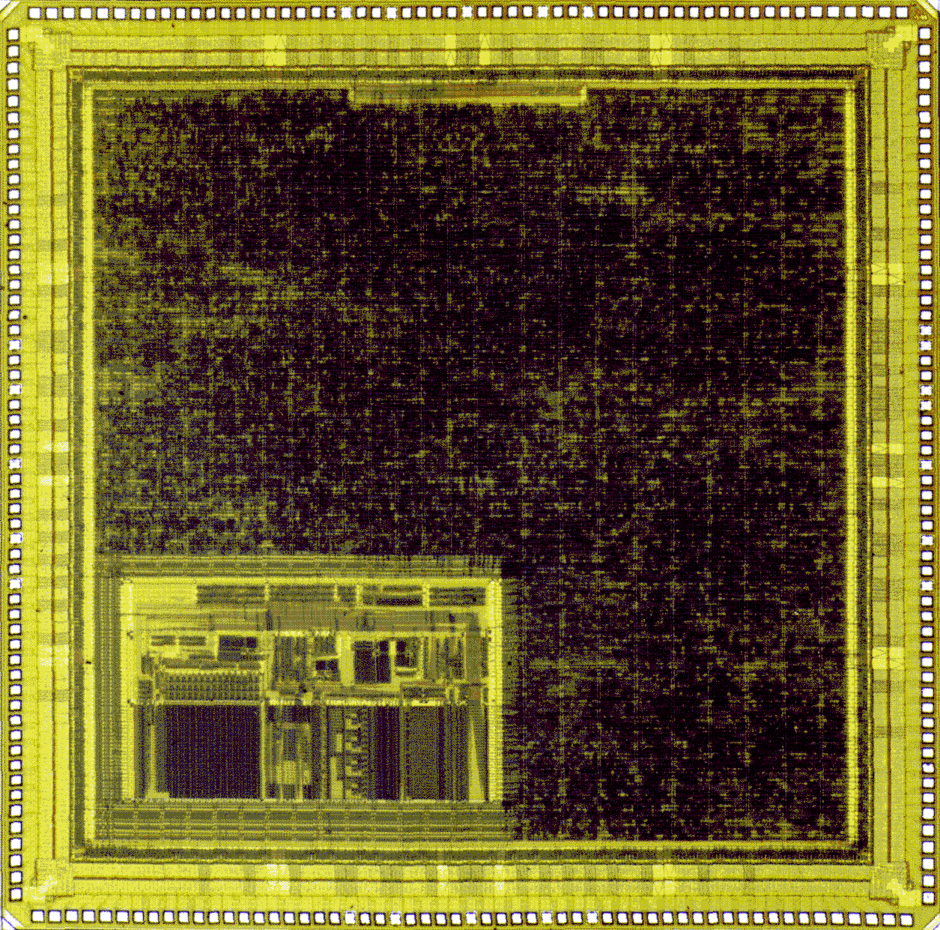
MANTIS µController - Physical
Par.
Port
PCMCIA
UART (2)
Path
of
BµILD
Bus
Timers
W’Dog
Arb’tr.
Misc.
Int’t.
Contr.
DMA
ARM7 Core
Memory
Interface

Slide 15
SPIDER Comm’s µController
Int<2>
DMA <2>
Chip selects
<4>
144TQFP
Bus
control
<6>
Enable
Watch-dog
Intr Ctlr
MPC
Address
<20>
Timers
DMA
Data
<16>
<5>
UART
Bus
Arbiter
BμILD Bus
Host I/F
<56>
PCMCIA
Clk & power control
Clock
ARM7
Core
Debug &
Test<6>
BBM
POR
Reset

Slide 16
BUTTERFLY µController
8 bits &
control
<12>
144 PQFP/TQFP
Chip selects
<4>
Enable
Watchdog
PPI
Bus
control
<9>
Int<2>
Intr Ctlr
Bus Arbiter
MPC
PWM
Timers
Address
<22>
Ten<2>
<5>
UART
Data
<32>
<5>
UART
ARM7
Core
Clk & power control
Clock
Debug &
Test <6>
BBM
POR
Reset

Slide 17
Availability
BUTTERFLY
MANTIS
SPIDER
Engineering
Samples
Now Oct / 95 Oct / 95
Production
Ramp
July / 95 Dec / 95 Dec/ 95

Slide 18
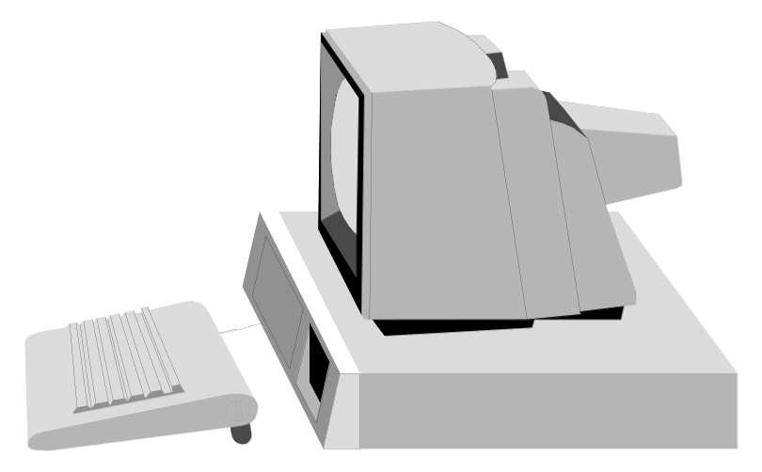

Development Support
Fully featured
Windowing debugger
and Toolkit
209
PGA
Fully documented -
Both on-line and hard copy
Dedicated Hardware - Microcontroller
Assessment Platform (MAP-1)

Slide 19
Development Board for µCs
96 way bus expansion port
Control &
Debug
SRAM Bank 2
8
5
C
3
0
RS422
Port
128kx32
SRAM Bank 1
Chl A
128kx32
Chl B
EPROM
(CIS/DEMON)
Serial
Comms
i/f
P
o
r
t
A
128kx8
w
a
y
3
4
16 bit
PCMCIA i/f
Parallel
Port i/f
GPS
micro-
controller
P
o
r
t
B
w
a
y
Clock
3
4
PLL
ADC/
DAC
Anlg in
Reset
Level
Converter
Anlg out
Intrpt
Serial
Port A
Serial
Port B

Slide 20
Development Board Features
Full PCMCIA slave interface
256k x 32 zero wait-state SRAM
8, 16 or 32 bit data transfers
128k x 8 Flash EPROM
96 pin expansion interface
2 DMA channels (mem - mem capable)
2 External Interrupts - priority programmable
2 External Timer inputs plus Watchdog Disable
Dual UART
Analogue input and output ports
Dual RS422 Serial Comms Controller
16 bi-directional I/O lines
Software support with Version 2 Toolkit for Windows™

Slide 21
Software Toolkit Overview
C COMPILER
ASSEMBLER
LIBRARY
LINKER
GPS GUI
DEBUGGER
EMULATOR
DEV. BOARD
TARGET SYSTEM

Slide 22
Software Toolkit Components
ANSI C Compiler
Assembler
Linker
ANSI C Library
C runtime library support
Line mode debugger
GUI with project support
Full MAKE utility included
UDB Windowing debugger
UMON target monitor
Full on-line documentation

Slide 23
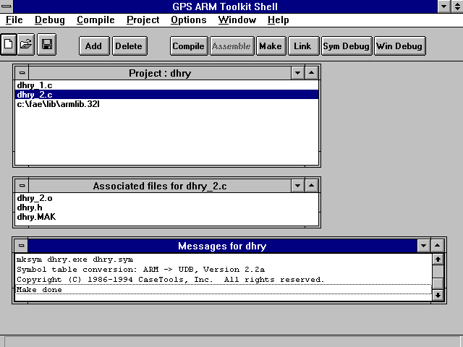
The Project Shell

Slide 24
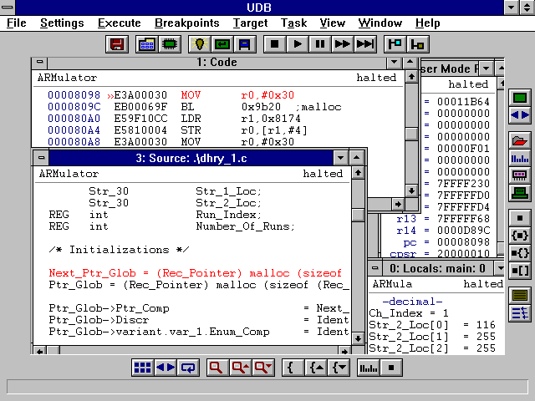
The UDB Debugger

Slide 25
In Summary OMI/DE has ...
Encouraged GPS to enter a market in which it had no prior experience. By supporting the establishment of appropriate base technology and methodology ...
... As a result GPS ...
  Established a specific Business Unit to exploit the technology.
  Developed a family of Standard Product Microcontrollers with development tools and drivers based on a modularity which allows ready customisation for Higher Value Opportunities.
But What Next ? ...

Slide 26
Customised µController
Improved
Macrofunctions
Interrupts
Reset
Clk
CLK/Power
Control
Interrupt
Control
POR
RAS/CAS
Programmable
Bus Interface
VDD
GND
8,16,32
ADDR
Timers
DMA
Data
Access
control
PCMCIA
On-chip
Memory
A
I
M
???
Core
Test
I/O I/F
ADC
DSP
eg: HDLC, ADSL, I2C
ISA/PCI
User
Specified / Designed
Macrofunctions
New Macrofunctions
Application specific interfaces
Host specific
I/F

Slide 27
Modular µC Design Methodology
Ready development of range of ‘Standard µCs’
Direct Design viable for µCs of volume >100k/yr
  Customised Si implementation with confidence
  Software development tools to support
  Debug environment available
Indirect Design for µCs <100k/yr
  Encourages the use of GPS µCs in ‘developing’ markets ...
    Standard Product µC with ‘gate array’ for market development :
    Customised µC for volume market exploitation.
  Ready support for test and characterisation
Target ... Push the 100K/yr Barrier down ... 50%/pa

Slide 28
System Support
Simulation/Emulation C Models of the Microcontrollers...
  Supports Early SW Development
    100k instructions/sec
  Supports HW/SW Partitioning
    Encourages ‘what-if’ assessments
  Supports Customised Controllers
    Allows modeling of ‘custom’ macrofunctions
    Embeddable in whole system model
  Supported by module oriented ‘debugger’
Improved Support Tools & Utilities...
  Configurable and Modular RTOS
  Configurable Compiler & Debugger
  Macrofunction Drivers

Slide 29


AMBA - ‘Greater Than The Sum of the Parts’
GPS and ARM Ltd have agreed to ...
  Synchronise their individual buses developed within OMI/DE.
  Waive their Patent rights on the resultant bus and offer it through OMI as a truly open standard, complementary to PI bus, for those Deeply Embedded IC’s where 'cost of ownership' vs 'performance', forms a critical equation.
Organisation and Dissemination discussions have started ...
  V1 of the Standard, with Spec. Models & Application Notes should be released before Q3/95
BµILD
EMB
AMBA
Advanced Microcontroller
Bus Architecture

Slide 30
AMBA - Speculative Feature List
Reference On-Chip-Only Bus for ...
  Master and Slave Macrofunction development.
  Ready Implementation of Customised µControllers
Multi-Master Bus
  32 bit address, 32 bit data.
  Parallel A/D, Multiplexed A/D & Burst Mode D
  Optional Pipeline
  Low Power / High Performance
Simple Macrofunction Interface
Module Based Manufacturing Test
Supports JTAG Hardware Debug
Broadcast Diagnostic Support
A Common ‘Root’ for New Support
Tool Development ...
  Hardware, Software & Debug
AMBA
Advanced Microcontroller
Bus Architecture

Slide 31
Was OMI/DE-ARM Successful for GPS ?
YES !
It ...
  Helped to develop a new business capability
  Helped to establish a new market opportunity
  Helped to improve GPS’s world position and credibility
Was it successful for Europe ?
  Business developed within GPS from the technology established in this program has brought many millions of ecu (Japanese, Taiwanese and American) into the European Community ...
  ... many times the grant income !

